Slide 1

Multiple Sources
Blended Acquisition

Slide 2

Polarcus’s Multiple-Source Initiative
“blended acquisition” with multiple sources
novel acquisition designs, and more data with the same quality

Slide 3
Blended Acquisition
more rapidly firing of shots with overlapping shot records
novel acquisition designs, and more data with the same quality
Notes:
firing shots in rapid succession, more rapidly than in a conventional acquisition, such that the respective shot records overlap, and leaving de-blending, that is the separation into individual shot records, to processing.
Here, you see two shot records, a green and an orange one, where the orange shot has been fired too “early” in conventional terms; the orange shot record overlaps with the green one.

Slide 4
De-Blending
“blended” = continuous
shot record
Notes:
With a succession of shots we get one big continuous shot record.
Blended data are, then, “de-blended”,

Slide 5
De-Blending
“blended” = continuous
shot record
other domain
target shot
aligned
Notes:
In order to de-blend the two shot records, firstly, we sort all the data into another domain, be it a common-midpoint, common-offset or other domain. Key point being, we sort the data such that the events of the green shot record align; then, because of the dithering of the shot times, the events of the orange shot record dis-align and appear as noise.
We strongly de-noise and assign remaining coherent energy to the green shot.
That coherent energy is removed from the original shot record.
Next, the remaining data are re-sorted such that the events of the orange shot record align; then, because of the dithering of the shot times, the events of the green shot record dis-align and appear as noise.
We strongly de-noise and assign remaining coherent energy to the orange shot.
This process is repeated several times, possibly in other domains, possibly with different de-noising tools.

Slide 6
De-Blending
“blended” = continuous
shot record
other domain
noise shot
re-aligned
Notes:
In order to de-blend the two shot records, firstly, we sort all the data into another domain, be it a common-midpoint, common-offset or other domain. Key point being, we sort the data such that the events of the green shot record align; then, because of the dithering of the shot times, the events of the orange shot record dis-align and appear as noise.
We strongly de-noise and assign remaining coherent energy to the green shot.
That coherent energy is removed from the original shot record.
Next, the remaining data are re-sorted such that the events of the orange shot record align; then, because of the dithering of the shot times, the events of the green shot record dis-align and appear as noise.
We strongly de-noise and assign remaining coherent energy to the orange shot.
This process is repeated several times, possibly in other domains, possibly with different de-noising tools.

Slide 7
De-Blending
“blended” = continuous
shot record
other domain
Cadzow
filtered
Notes:
In order to de-blend the two shot records, firstly, we sort all the data into another domain, be it a common-midpoint, common-offset or other domain. Key point being, we sort the data such that the events of the green shot record align; then, because of the dithering of the shot times, the events of the orange shot record dis-align and appear as noise.
We strongly de-noise and assign remaining coherent energy to the green shot.
That coherent energy is removed from the original shot record.
Next, the remaining data are re-sorted such that the events of the orange shot record align; then, because of the dithering of the shot times, the events of the green shot record dis-align and appear as noise.
We strongly de-noise and assign remaining coherent energy to the orange shot.
This process is repeated several times, possibly in other domains, possibly with different de-noising tools.

Slide 8
De-Blending
“blended” = continuous
shot record
other domain
target shot
aligned
noise model
Notes:
In order to de-blend the two shot records, firstly, we sort all the data into another domain, be it a common-midpoint, common-offset or other domain. Key point being, we sort the data such that the events of the green shot record align; then, because of the dithering of the shot times, the events of the orange shot record dis-align and appear as noise.
We strongly de-noise and assign remaining coherent energy to the green shot.
That coherent energy is removed from the original shot record.
Next, the remaining data are re-sorted such that the events of the orange shot record align; then, because of the dithering of the shot times, the events of the green shot record dis-align and appear as noise.
We strongly de-noise and assign remaining coherent energy to the orange shot.
This process is repeated several times, possibly in other domains, possibly with different de-noising tools.

Slide 9
De-Blending
“blended” = continuous
shot record
other domain
noise model
subtracted
noise model
Notes:
In order to de-blend the two shot records, firstly, we sort all the data into another domain, be it a common-midpoint, common-offset or other domain. Key point being, we sort the data such that the events of the green shot record align; then, because of the dithering of the shot times, the events of the orange shot record dis-align and appear as noise.
We strongly de-noise and assign remaining coherent energy to the green shot.
That coherent energy is removed from the original shot record.
Next, the remaining data are re-sorted such that the events of the orange shot record align; then, because of the dithering of the shot times, the events of the green shot record dis-align and appear as noise.
We strongly de-noise and assign remaining coherent energy to the orange shot.
This process is repeated several times, possibly in other domains, possibly with different de-noising tools.

Slide 10
De-Blending
“blended” = continuous
shot record
other domain
target shot
aligned
noise shot
re-aligned
noise model
updated
Cadzow
filtered
noise shot
Notes:
In order to de-blend the two shot records, firstly, we sort all the data into another domain, be it a common-midpoint, common-offset or other domain. Key point being, we sort the data such that the events of the green shot record align; then, because of the dithering of the shot times, the events of the orange shot record dis-align and appear as noise.
We strongly de-noise and assign remaining coherent energy to the green shot.
That coherent energy is removed from the original shot record.
Next, the remaining data are re-sorted such that the events of the orange shot record align; then, because of the dithering of the shot times, the events of the green shot record dis-align and appear as noise.
We strongly de-noise and assign remaining coherent energy to the orange shot.
This process is repeated several times, possibly in other domains, possibly with different de-noising tools.

Slide 11
De-Blending
“blended” = continuous
shot record
other domain
noise shot
re-aligned
noise model
subtracted
noise model
updated
Cadzow
filtered
noise shot
Notes:
In order to de-blend the two shot records, firstly, we sort all the data into another domain, be it a common-midpoint, common-offset or other domain. Key point being, we sort the data such that the events of the green shot record align; then, because of the dithering of the shot times, the events of the orange shot record dis-align and appear as noise.
We strongly de-noise and assign remaining coherent energy to the green shot.
That coherent energy is removed from the original shot record.
Next, the remaining data are re-sorted such that the events of the orange shot record align; then, because of the dithering of the shot times, the events of the green shot record dis-align and appear as noise.
We strongly de-noise and assign remaining coherent energy to the orange shot.
This process is repeated several times, possibly in other domains, possibly with different de-noising tools.

Slide 12
De-Blending
“blended” = continuous
shot record
other domain
s
h
o
t
s
d
i
t
h
e
r
e
d
Notes:
In order to de-blend the two shot records, firstly, we sort all the data into another domain, be it a common-midpoint, common-offset or other domain. Key point being, we sort the data such that the events of the green shot record align; then, because of the dithering of the shot times, the events of the orange shot record dis-align and appear as noise.
We strongly de-noise and assign remaining coherent energy to the green shot.
That coherent energy is removed from the original shot record.
Next, the remaining data are re-sorted such that the events of the orange shot record align; then, because of the dithering of the shot times, the events of the green shot record dis-align and appear as noise.
We strongly de-noise and assign remaining coherent energy to the orange shot.
This process is repeated several times, possibly in other domains, possibly with different de-noising tools.

Slide 13
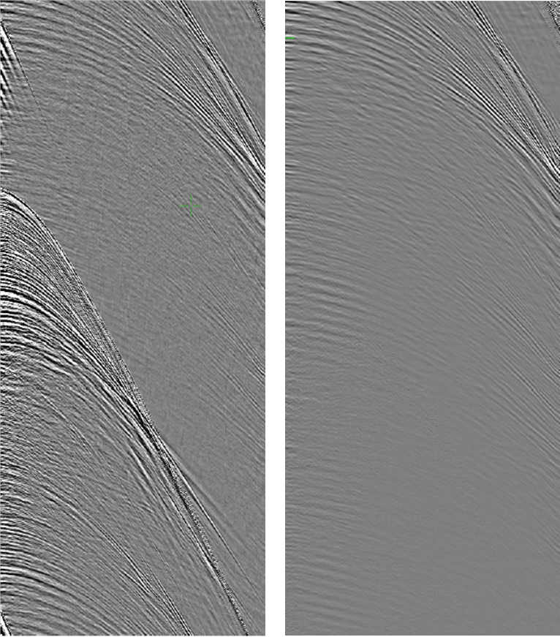
De-Blending

Slide 14
Fieldtest: Peak Pressure
nominal

Slide 15
Fieldtest: Peak-to-Trough Pressure
nominal

Slide 16
Fieldtest: Peak-to-Bubble Ratio
nominal

Slide 17

Blended Acquisition De-Blending in Processing
too rapid a succession of shot firing
more data
to be demonstrated
novel source/streamer layouts
better image quality

Slide 18
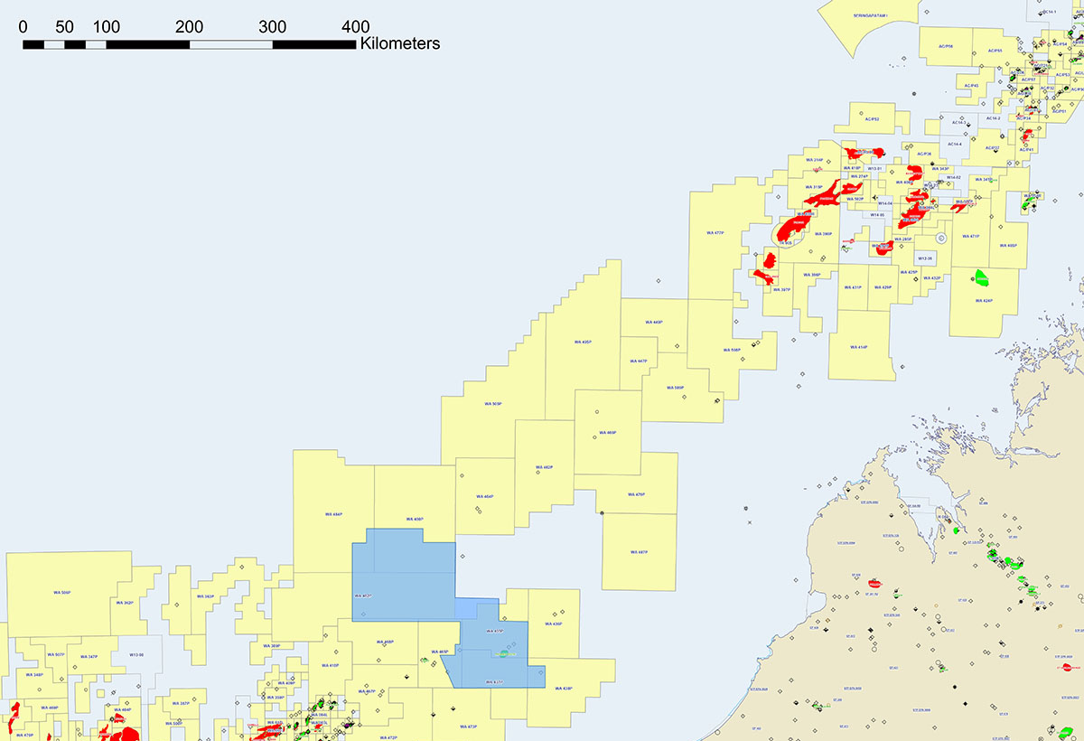
Case History: Capreolus 3D Survey

Slide 19
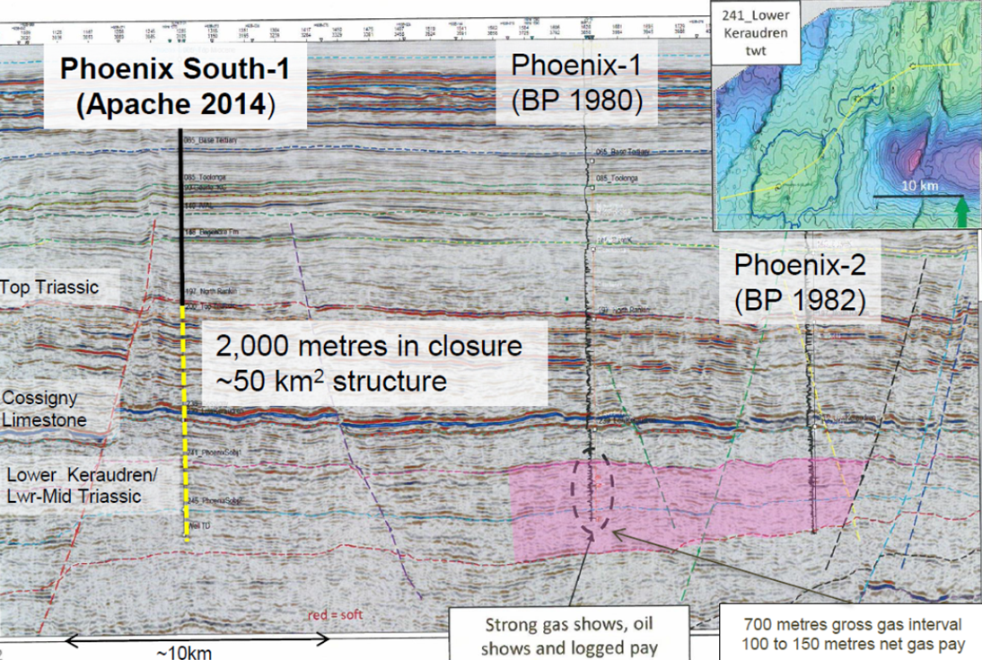
Gas until Drilled
(Carnavon
Petroleum)

Slide 20
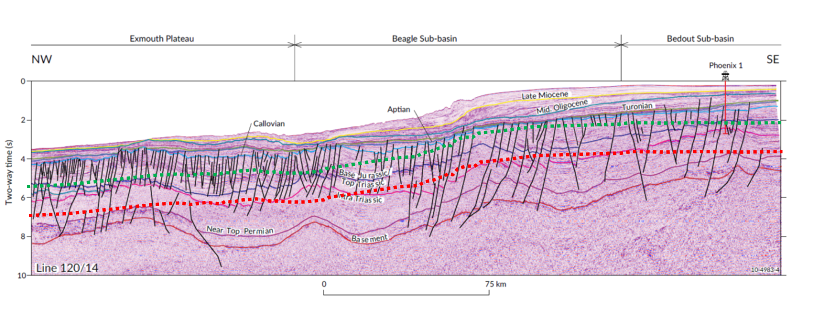
AGSO Regional Line

Slide 21







Acquisition parameters
VESSELS POLARCUS ASIMA / AMANI / NAILA
SOURCE Bolt 1500-LL/1900-LLXT dual sources
Volume 3480-in³
Array/Sub-Array Seps. 50m / 7.0m
Depth 7m (+/-0.5m)
Operating Pressure 2000 psi
Shot interval 12.5m flip/flop
STREAMERS Sercel Sentinel Solid
Number x Length of Str. 12 x 8100m (Phoenix area) 12 x 9000m (Beagle/Exmouth area)
Streamer Spacing 100m
Number of Groups per Str. 648/720
Depth of Streamer 17.5m (+/- 1m)
RECORDING SYSTEM SERCEL SEAL 2,000 channels + 48 aux
Sample Rate 2 ms
Lo Cut Analog 2 Hz + Digital 2 Hz(12dB)
Recording Mode Continuous
Record Length* 12.0 sec
Format SEG-D, 8058
Media 3592 Cartridge
GRAVITY & MAGNETIC DATA (WA-480P & WA-484P)
Contractor EDCON-PRJ
Gravity meter LaCoste & Romberg Model S with AirSea System II computer controller
Magnetometer SeaSpy by Marine Magnetics
Deliverables Processed digital data (CD-ROM), Maps, Final report

Slide 22
De-Blending

Slide 23
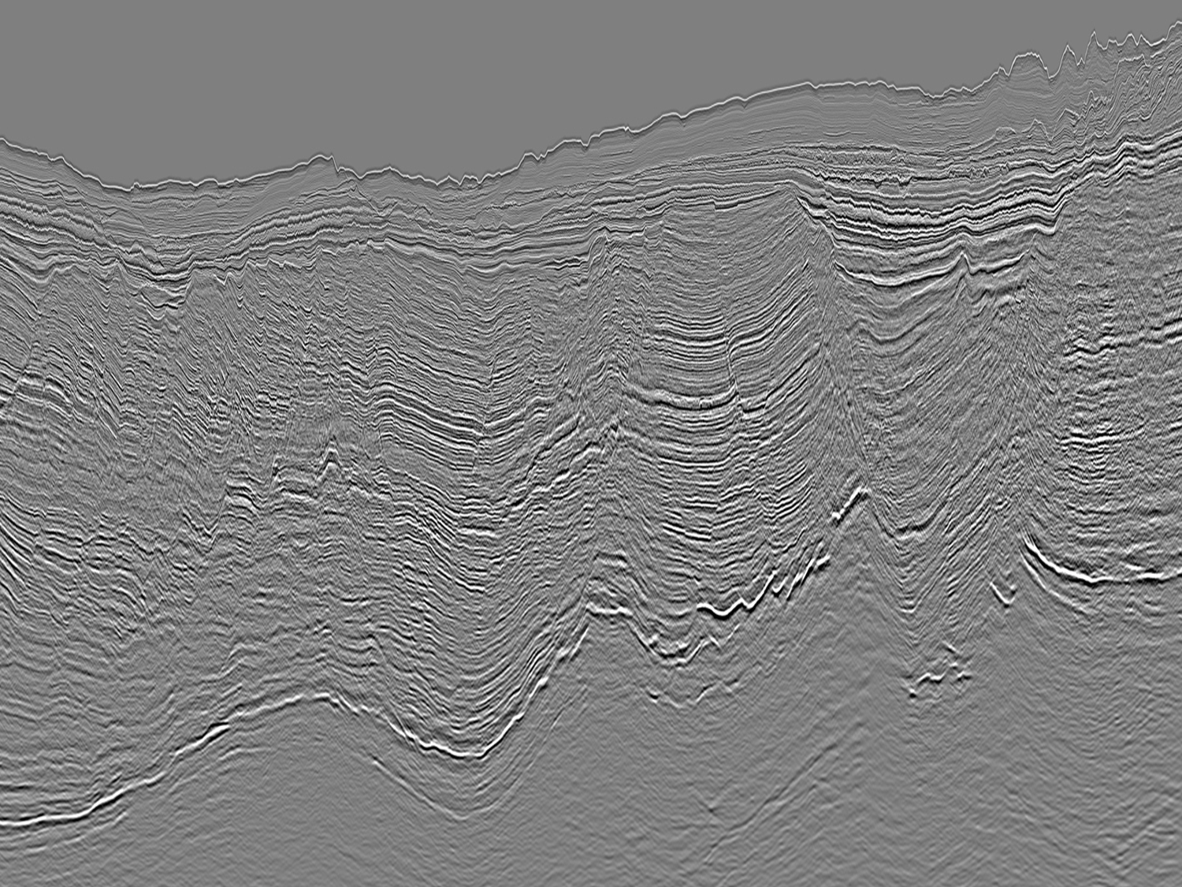

Slide 24

Triple Sources

Slide 25
State-of-Art: Dual Source in Flip-Flop Mode
dual

Slide 26
Dual versus Triple Source
shot-point interval increases
fold decreases
bad idea
too much noise
reduced speed uneconomical
dual
triple

Slide 27
Enabling Triple Source
blended acquisition
shot-point interval not constrained
Notes:
So, what are we doing with the third source, then?

Slide 28
Dual Source
1/4 streamer
separation

Slide 29
Wide Triple Source
+1/2 more streamer spread

Slide 30
Narrow Triple Source
1/6 streamer
separation

Slide 31
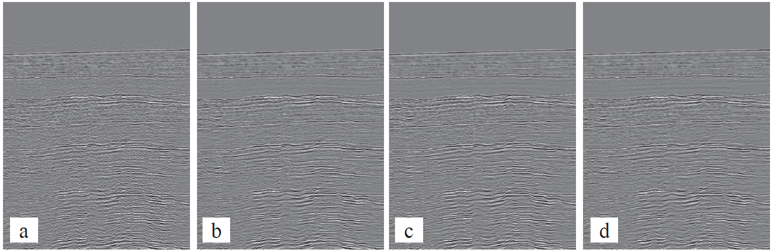
Concept Proven
TGS West-of-Shetland | triple | 12.5 > 12.5 | simultaneous ± 300ms dither
TGS Europa | triple | 12.5 > 37.5 | sequential overlapping
triple
left
middle
right
TGS, West-of-Shetland survey
(Liu et al., 2015)

Slide 32
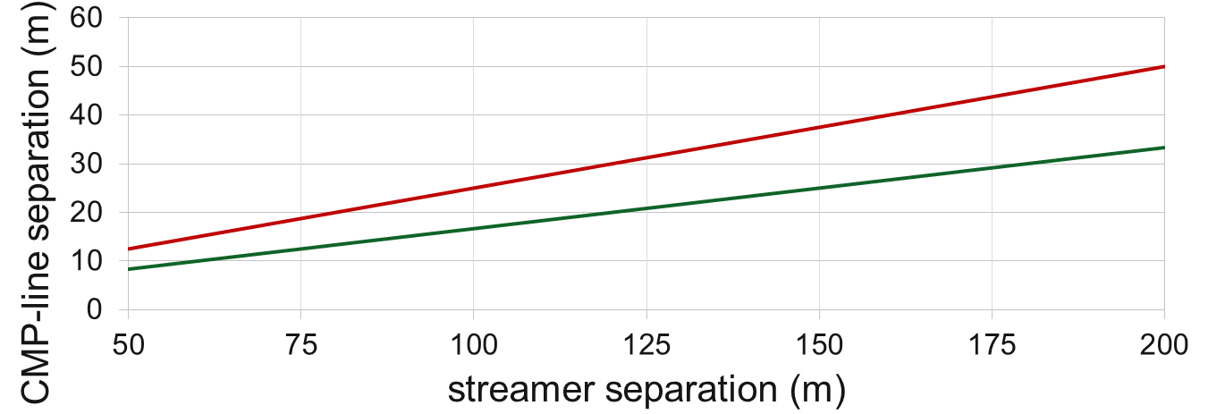
CMP-Line Separation versus Streamer Separation
dual
streamer separation
triple
streamer separation

Slide 33
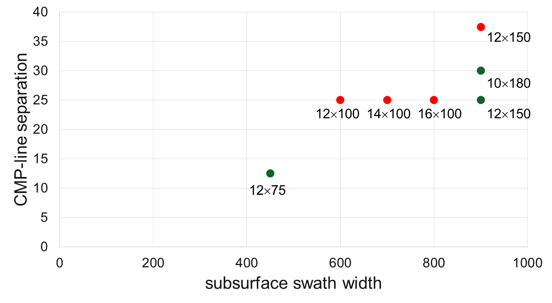
CMP-Line Separation versus Subsurface Swath Width
dual
triple

Slide 34
Recommendation
Deep-water survey
10 × 180 × 10,000 with ΔCMP=30m and long offsets
12 × 150 × 8,100 with ΔCMP=25m
Shallow-water survey
12 × 75 × 8,100 with ΔCMP=12.5m
High-density survey
12 × 75 × 8,100 with ΔCMP=12.5m

Slide 35
Triple Source
equal / smaller shot-point interval = equal/better in-line fold
larger sub-surface swath width, or smaller CMP-line separation
more shot- / CMP-points (per time) more rays into the ground
proven concept
TGS West-of-Shetland, 12.5 > 12.5, simultaneous
TGS Barents Sea, 12.5 > 37.5, overlapping sequential

Slide 36
Penta Sources

Slide 37
Dual Source = 6 Airgun Strings

Slide 38
6 Airgun Strings Re-Configured
2 strings to 1 source
firing sequence

Slide 39
Shotpoint Interval
3s shot-time interval
over 37.5m 5×6.945m penta versus 3×12.5m or 2×18.75m flip-flop dual
unlimited shot records
less source-generated noise
3s

Slide 40
6 Airgun Strings Re-Configured
12.5m shot-line separation
12.5m
12.5m

Slide 41
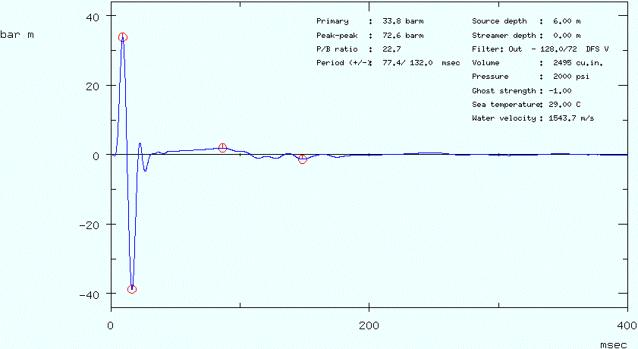
Far-Field Signal Inside Left+Right

Slide 42
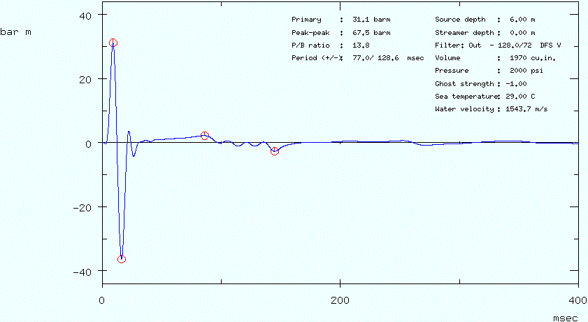
Far-Field Signal Left Outside+Center

Slide 43
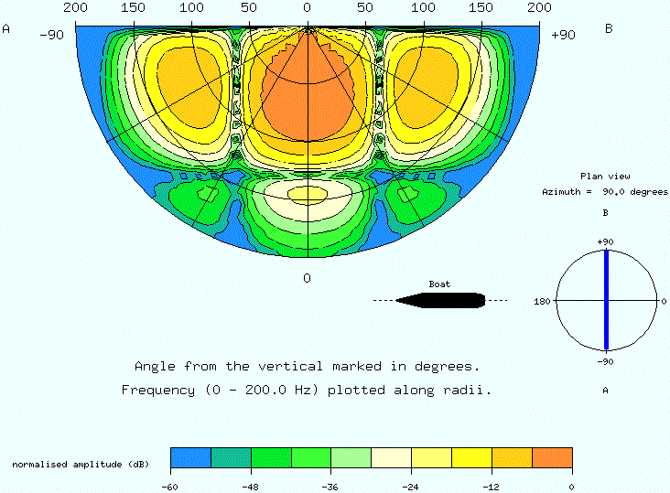
Source Directivity: Cross-Line Inside Left+Right

Slide 44
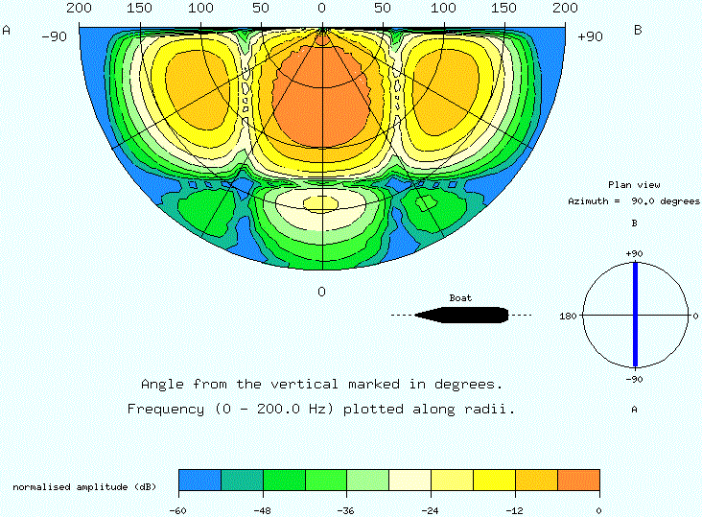
Source Directivity: Cross-Line Left Outside+Center

Slide 45
6 Airgun Strings Re-Configured
6.25m CMP-line separation
true, not virtual data
62.5m
12.5m
6.25m

Slide 46
Penta Source
6.25m CMP-line separation
5 versus 2 or 3 shots per 37.5m with arbitrary record length
for shallow targets

Slide 47
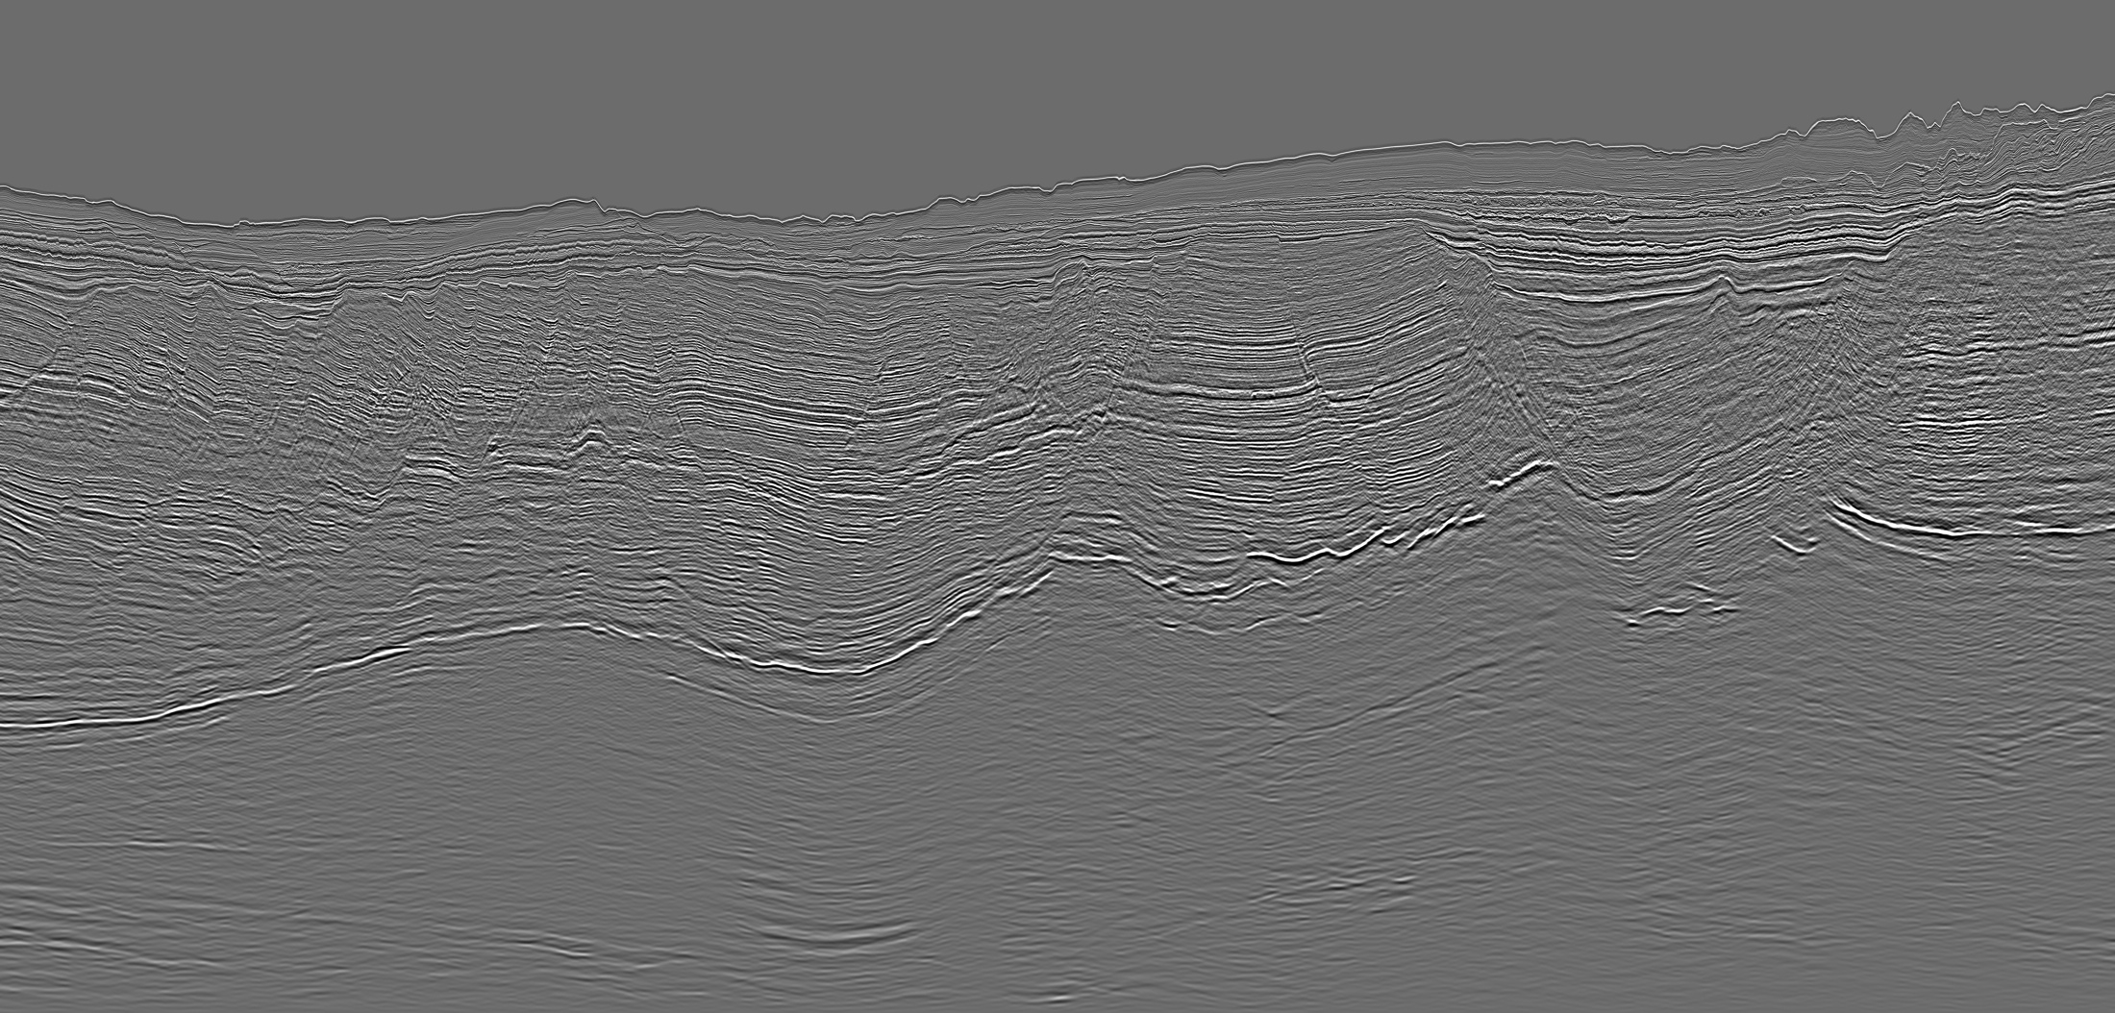
Summary
blended acquisition + de-blending in processing
more in-line shots / more source lines
larger sub-surface swath width smaller CMP-line separation
higher productivity ⇒ faster turn-around more data ⇒ better data quality
proven concept
dual source: Capreolus
triple source: West-of-Shetland and Barents Sea; ongoing field test
penta source: awaiting award

